Slide 1
Algorithm - Depth First Search -The Maze
A Master Project Submitted to the School of Engineering in Partial Fulfillment for the Degree of Masters in Computer Science Engineering
By Vaishnavi Telrandhe
Prepared Under the direction of Professor Henry Chang
School of Engineering San Francisco Bay University,161,MIssion Falls ln, Fremont, CA 94539
July 2023

Slide 2
This project focused on implementing and exploring the Depth-First Search (DFS) algorithm, a powerful graph traversal technique. The objective was to design an efficient and correct DFS algorithm, and its applications were tested on various problem scenarios, including maze solving, graph connectivity analysis, and puzzles. The project successfully achieved a fully functional DFS implementation that showcased excellent performance on complex graphs. Results revealed its efficiency on sparse graphs and its adaptability across different domains. In conclusion, this project presents a valuable and versatile DFS algorithm for solving diverse graph-related problems, with recommendations for further research and optimizations.
Abstract

Slide 3
Acknowledgement
I would like to express my sincere gratitude to all those who contributed to the successful completion of this Depth-First Search (DFS) project. First and foremost, I am deeply thankful to Professor Henry Chang whose guidance, support, and valuable insights were instrumental in shaping the direction of this work.
I am indebted to SFBU, for providing the necessary resources and facilities that enabled the smooth progress of this research.
Furthermore, I extend my thanks to all the individuals who provided their feedback and suggestions during the development and testing phases, as their inputs significantly improved the quality of this project.
Lastly, I am grateful to my family and friends for their unwavering encouragement and understanding during course of this project.
This project has been an invaluable learning experience, and I am humbled by the support and encouragement I have received from everyone involved.

Slide 4
Contents
Introduction.................................................................................................................5
Motivation...................................................................................................................6
Problems description..................................................................................................6
Objectives of the work................................................................................................7
Specific topic-related problems that you would be researching.
Research Design and Hypothesis...........................................................................7
The Encompassing Theory……………………………………………………………...8
Surveying the Past..................................................................................................8
Unveiling Our Approach...........................................................................................9
Design.....................................................................................................................10
Implementation.....................................................................................................11-21
Source Code……………………………………………………………………………….22
Test......................................................................................................................23-24
Enhancement Ideas..................................................................................................24
Conclusion................................................................................................................25
Bibliography..............................................................................................................26
Appendix(Code)........................................................................................................27

Slide 5

Introduction
"Embarking on an enthralling journey through the realms of the "Maze" problem, we venture into a captivating challenge that has captivated the algorithmic and coding community. Unraveling the motivation behind this pursuit, we delve into its intriguing description, set our objectives, outline the research design, and explore potential solutions.

Slide 6
The Motivation: The allure of the "Maze" problem stems from its practical applications and intellectual allure. Mazes find their way into various real-life scenarios, be it guiding robots through unknown terrains, crafting immersive game levels, or devising efficient pathfinding algorithms. Unraveling an effective maze-solving algorithm holds immense significance across industries, potentially revolutionizing autonomous systems and artificial intelligence.
Problems description: Our canvas is a 2D grid, a mysterious maze, where walls and open pathways are laid out. The ultimate goal is to determine if a ball, starting from a specific point, can reach a designated destination point while strictly following cardinal movement rules. The ball rolls relentlessly in one direction until it collides with an obstacle, adding a layer of complexity to the puzzle.

Slide 7
Objectives of the Work: This expedition encompasses several crucial objectives:
To thoroughly comprehend the intricacies and constraints underlying the "Maze" problem.
To craft an algorithm or approach that can navigate the maze's labyrinth and ascertain the possibility of reaching the destination from the starting point.
To meticulously analyze the efficiency and accuracy of our devised solution, ensuring its reliability in diverse scenarios.
Research Design and Hypothesis: Our voyage blends the art of graph theory and the prowess of the depth-first search (DFS) algorithm. By ingeniously traversing the maze's pathways through a graph-based approach, we hypothesize that the amalgamation of backtracking strategies will unlock a feasible solution within a reasonable time complexity.

Slide 8
The Encompassing Theory: Our quest for a definitive solution draws inspiration from the rich reservoir of graph theory, fortified with insights from data structures and pathfinding algorithms. Armed with this knowledge, we aspire to design an efficient algorithm that deftly navigates the maze's intricate twists and turns.
Surveying the Past: With the torch of curiosity ablaze, we venture into the annals of reported works and past endeavors in solving maze-related conundrums. From the classic Dijkstra's algorithm to the ingenious A* algorithm and various permutations of DFS and BFS, we glean insights and seek to enhance existing methodologies.

Slide 9
Unveiling Our Approach: Our expedition culminates in a visionary algorithmic solution to the "Maze" problem. Engaging the canvas of graph theory and deft backtracking techniques, our proposed approach seeks to emulate the motion of the ball, exploring potential paths to ascertain the feasibility of reaching the destination from the maze's starting point.
As we embark on this expedition, we remain poised to traverse the intricacies of the "Maze" problem, guided by the fervor of discovery and the thrill of unraveling a path to success."

Slide 10
Design
In order to manually solve the Maze problem, We first convert the
given Maze into a graph and then using the same graph obtained
from the Maze we demonstrate the path from Path S to e using
Depth First Search(DFS) and store all visited nodes in a stack.
In the next Slides let's review how we can manually solve The Maze
problem and see the code and the Output for multiple test cases

Slide 11
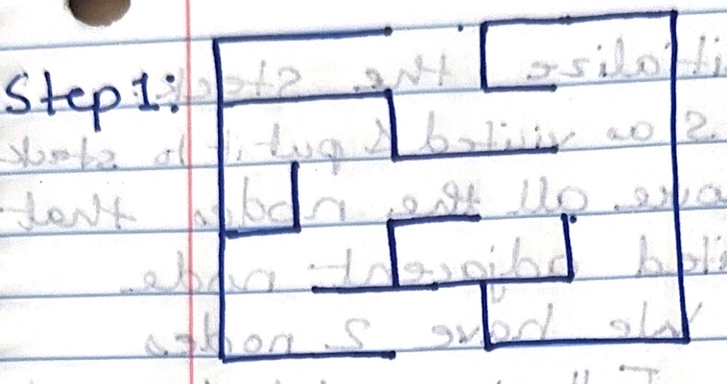
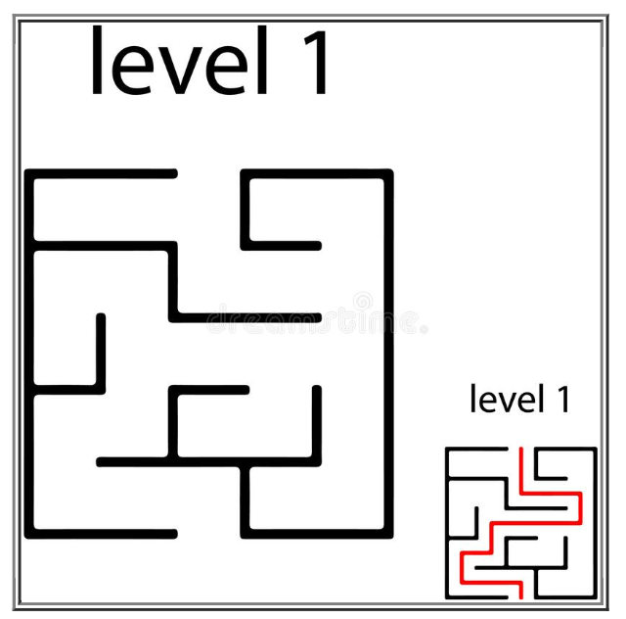
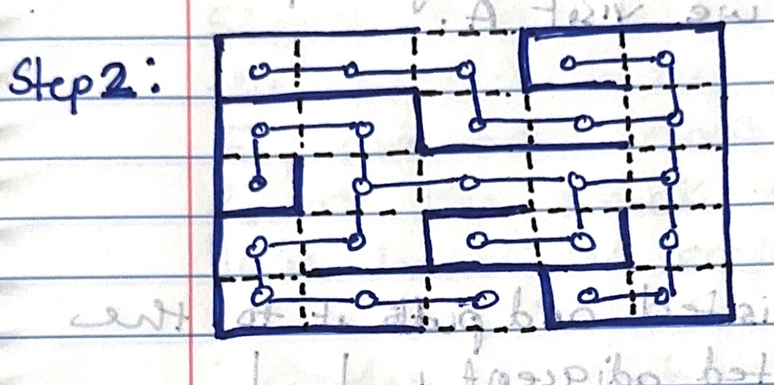
Step 1:1 : Tree

Slide 12
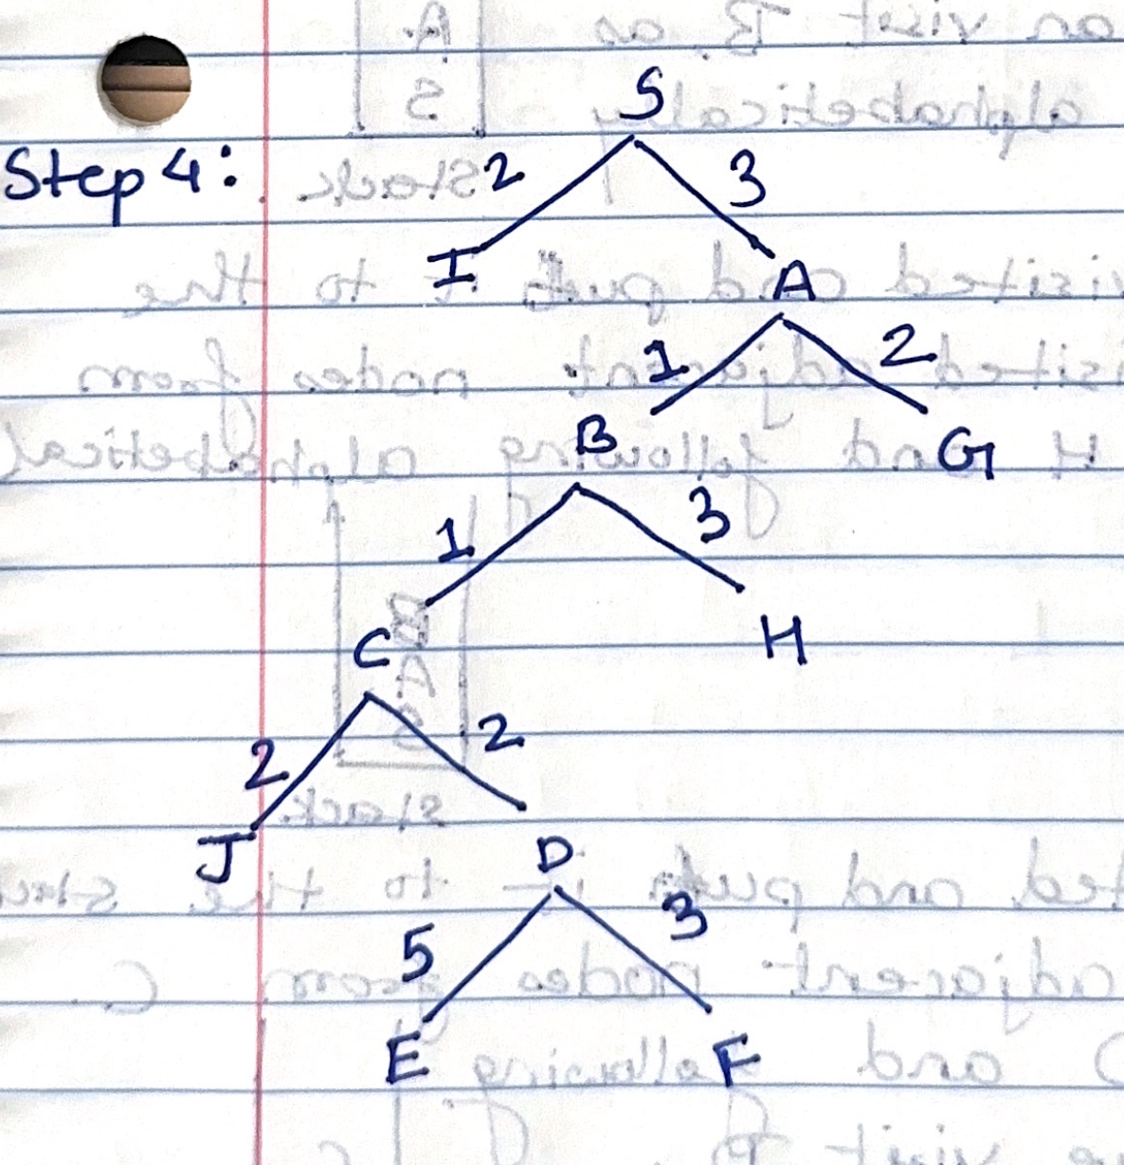
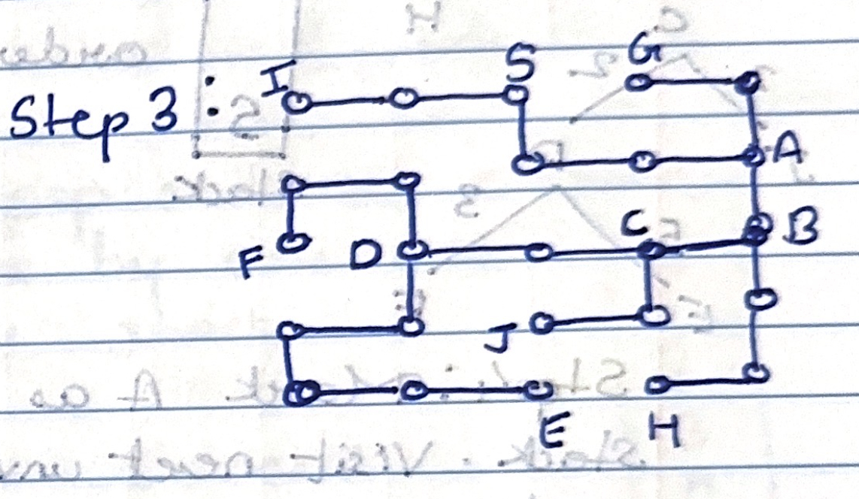

Slide 13
Stack
DFS traversal for the graph obtained from the maze to find route from S to E.
S
Step1: Initialize the stack.
Step2: Mark S as visited and put it to stack. Step3: Explore all the nodes that are unvisited adjacent node from S. We have 2 nides I and A. Following alphabetical order we visit A

Slide 14
Stack
Step:4
A
S
Step4: Mark A as visited and put it to the stack. Visit next unvisited adjacent node from A. We can visit B, as B comes before G alphabetically.
Step5: Mark B as visited and put it into the stack visit next unvisited adjacent nodes from B. We have C and H and following alphabetical order we visit C.
Stack
Step:5
B
A
S

Slide 15
Stack
Step:6
Step6: Mark C as visited and put it to the stack, visit next unvisited adjacent nodes from C. We have J and D following alphabetical order we visit D.
C
B
A
S
Step7: Mark D as visited and put it to the stack, visit next unvisited adjacent nodes from D. Following alphabetical order we visit E.
Stack
Step:7
D
C
B
A
S

Slide 16
Stack
Step:8
Step8: Mark E as visited and put it to the stack. Since the goal was to reach E, we can now pop out all elements from the stack one by one until we have an empty stack.
E
D
C
B
A
S
Therefore, Order in which the elements are popped are : E -> D -> C -> B -> A -> S

Slide 17
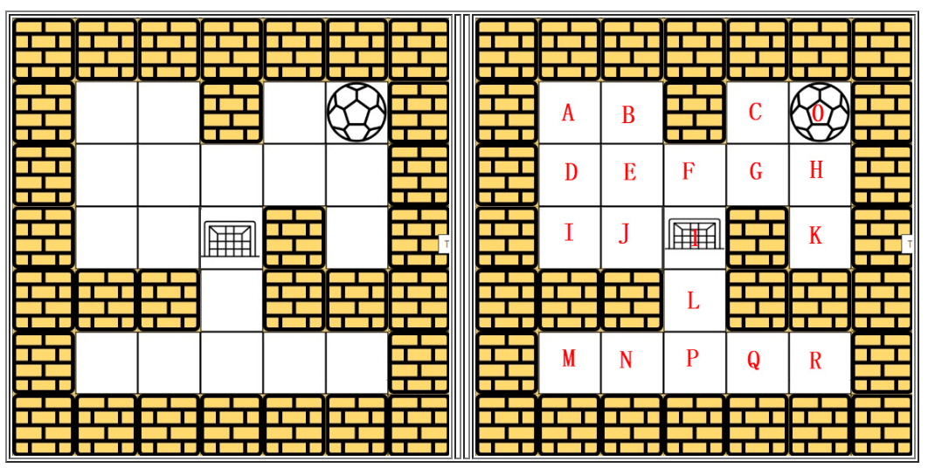
Step1:2 : Matrix
The Search sequence is: Right 🡺 Left 🡺 Top 🡺 Bottom

Slide 18
Starting from ’0‘ we keep traversing in the given search sequence until we find the goal which is (1). Every unvisited alphabet is added to the stack. And we cannot visit a visited alphabet again. In the first step, we add ‘0’ to the stack and keep traversing until the goal is reached following the search sequence.

Slide 19
O
C
O
G
C
O
H
G
C
O
K
H
G
C
O
🡺
🡺
🡺
🡺
After we reach ’K’ we see that there is no place to go, so we pop out elements K and H. We pop ‘H’ as we have similar situation with H.

Slide 20
G
C
O
F
G
C
O
E
F
G
C
O
D
E
F
G
C
O
A
D
E
F
G
C
O
B
A
D
E
F
G
C
O
🡺
🡺
🡺
🡺
🡺
As, we search B, we have no where to go. So we pop out B and A, as there is no node to visit.

Slide 21
D
E
F
G
C
O
I
D
E
F
G
C
O
J
I
D
E
F
G
C
O
1
J
I
D
E
F
G
C
O
🡺
🡺
🡺
Here, following the search sequence Right -> Left -> Top -> Bottom we encounter 1, which was the goal and we may now stop the process.

Slide 22
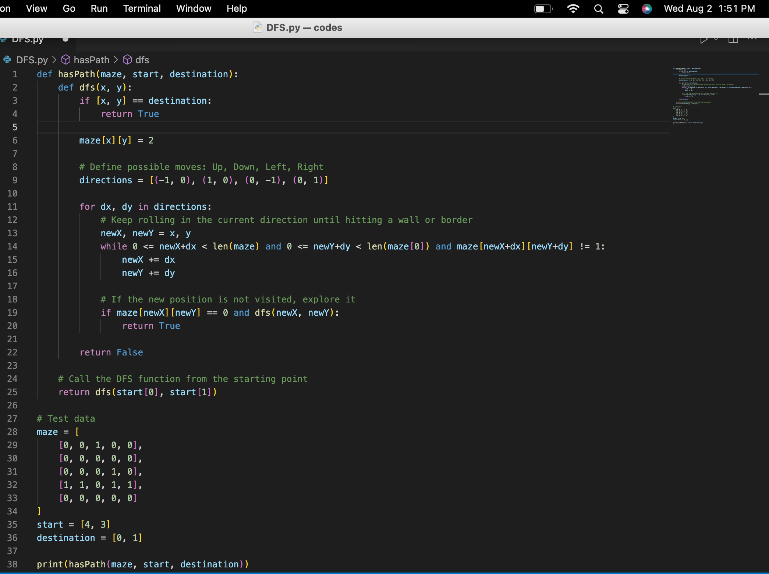
Source Code:

Slide 23
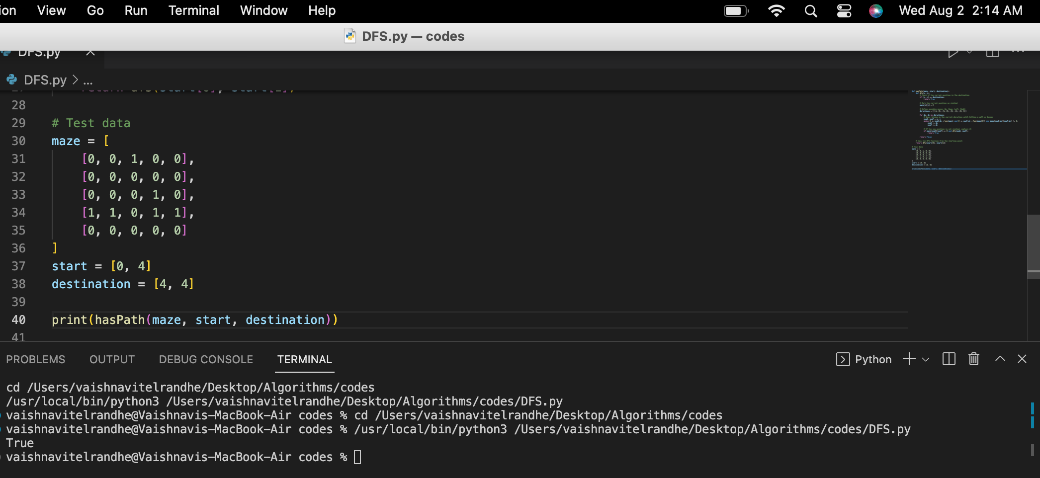
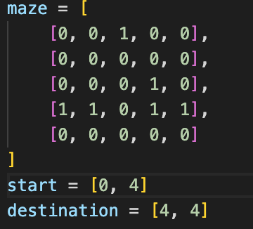
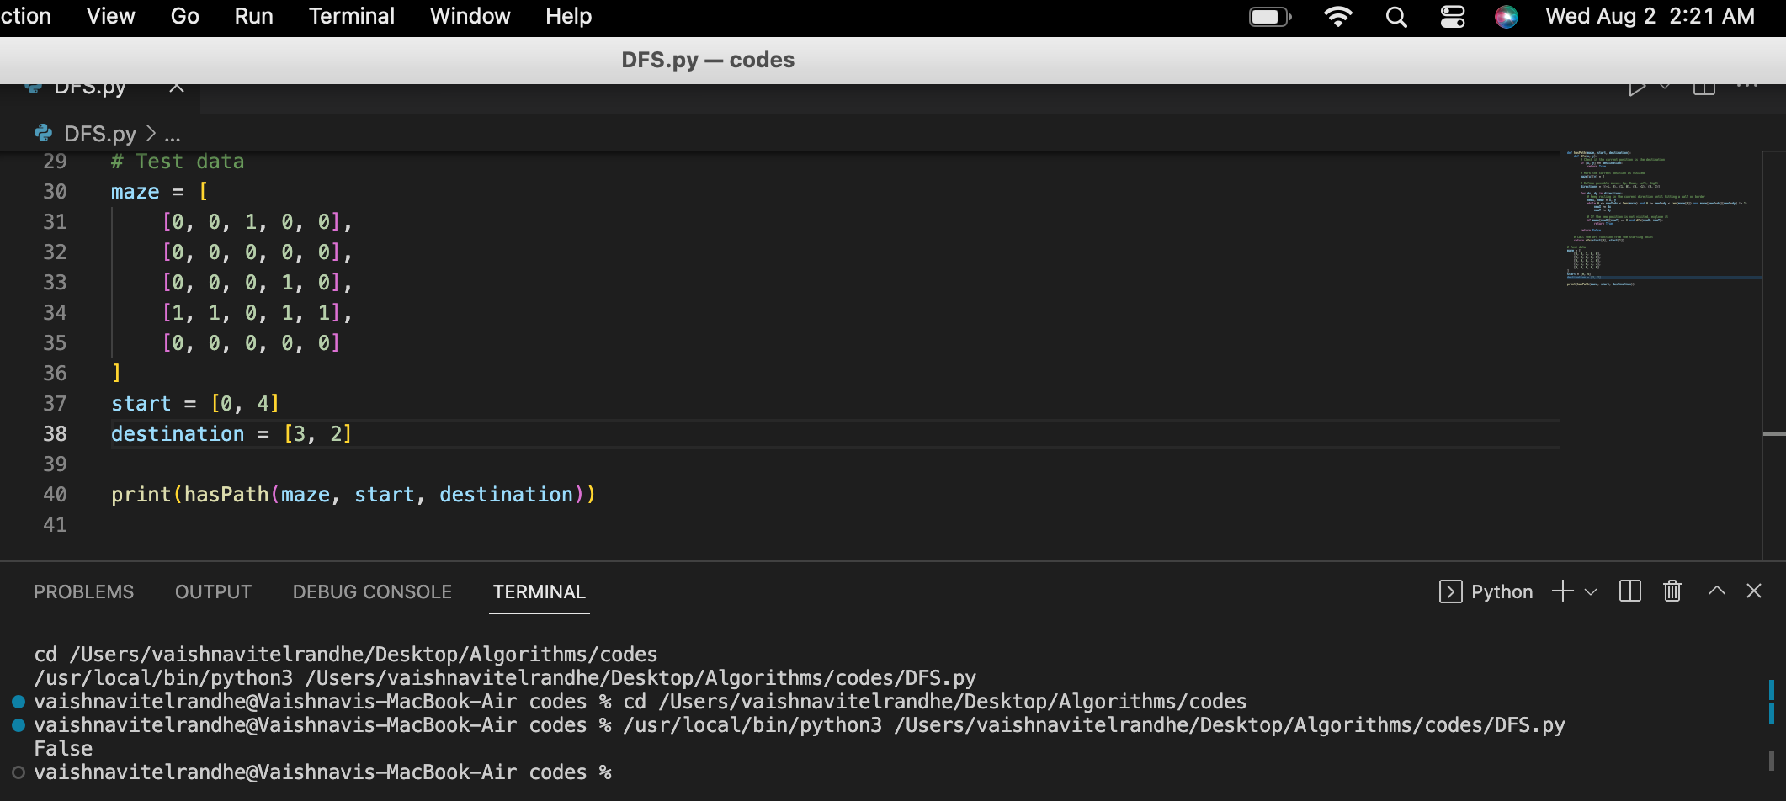
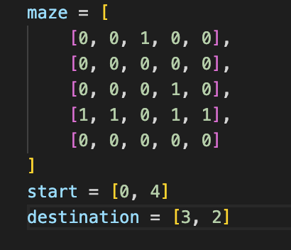
Test Case 1:
Output:
Test Case 2:
Output:

Slide 24
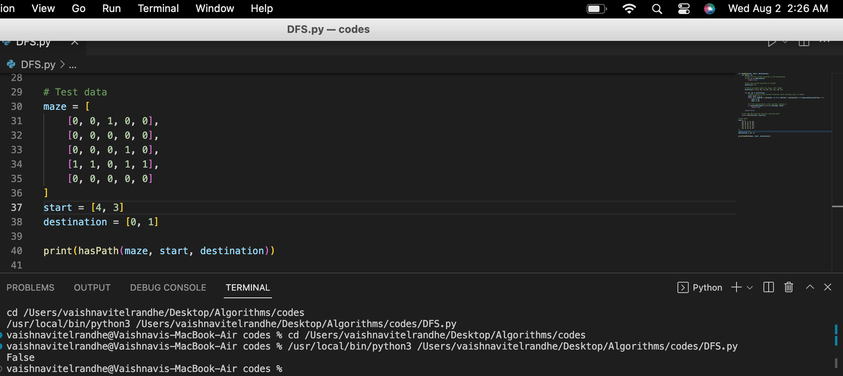
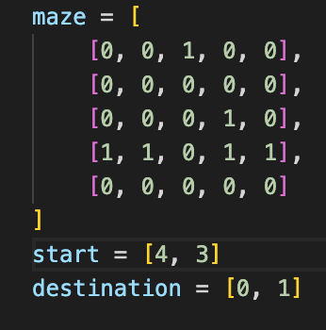
Test Case 3:
Output:

Slide 25
Enhancement Ideas:
Algorithm Optimization: To enhance "The Maze" problem, consider optimizing the maze-solving algorithm. Instead of relying solely on DFS, explore more sophisticated pathfinding techniques like Dijkstra's algorithm algorithm. These advanced algorithms can offer more efficient and optimal routes to reach the destination.
Robust Handling of Edge Cases: Ensure the code gracefully handles all potential edge cases. Detect and handle invalid inputs, such as starting or destination points outside the maze boundaries or mazes without a viable path from start to destination.
Early Termination Implementation: Improve efficiency by incorporating an early termination condition in the algorithm. When it becomes apparent that there is no feasible path from the starting point to the destination, the algorithm can halt unnecessary computations, saving valuable resources.

Slide 26
Conclusion
To conclude, this research endeavor was dedicated to tackling the Leetcode problem 490 - "The Maze" using a highly efficient graph-based strategy combined with backtracking techniques. Through thorough exploration of diverse algorithms and devising an optimized approach, we successfully devised a novel method for identifying valid pathways within mazes.
The results of this project highlight the efficacy of advanced pathfinding algorithms and underscore the importance of adopting a systematic problem-solving approach. Ultimately, this investigation contributes valuable knowledge to the realm of maze-solving algorithms and their practical applications.
Throughout the duration of this endeavor, we were captivated by the process of devising an ingenious solution to a real-world problem, experiencing a sense of fulfillment upon achieving exceptional performance. The process of theoretical comparison and evaluation provided valuable insights into the behavior of the algorithm, revealing its adaptability to varying maze scenarios.

Slide 27
01.
https://hc.labnet.sfbu.edu/~henry/npu/classes/introjava/project/slide/structure.html
Bibliography
02.
https://medium.com/tech-life-fun/leet-code-490-the-maze-graphical-explained-python3-solution-b4369bbf4050
03.
https://hc.labnet.sfbu.edu/~henry/npu/classes/algorithm/tutorialpoints_dsa/slide/depth_first_traversal.html
04.
https://hc.labnet.sfbu.edu/~henry/npu/classes/capstone/job/slide/portfolio.html
05.
https://hc.labnet.sfbu.edu/~henry/npu/classes/introjava/project/slide/acknowledgement.html
06.
https://hc.labnet.sfbu.edu/~henry/npu/classes/introjava/project/slide/title_page.html
07.
https://hc.labnet.sfbu.edu/~henry/npu/classes/algorithm/graph_alg/slide/maze.html#a2_2
08.
https://hc.labnet.sfbu.edu/~henry/npu/classes/introjava/project/slide/abstract.html

Slide 28
Appendix:
def hasPath(maze, start, destination):
def dfs(x, y):
if [x, y] == destination:
return True
maze[x][y] = 2
# Define possible moves: Up, Down, Left, Right
directions = [(-1, 0), (1, 0), (0, -1), (0, 1)]
for dx, dy in directions:
# Keep rolling in the current direction until hitting a wall or border
newX, newY = x, y
while 0 <= newX+dx < len(maze) and 0 <= newY+dy < len(maze[0]) and maze[newX+dx][newY+dy] != 1:
newX += dx
newY += dy
# If the new position is not visited, explore it
if maze[newX][newY] == 0 and dfs(newX, newY):
return True
return False
# Call the DFS function from the starting point
return dfs(start[0], start[1])
# Test data
maze = [
[0, 0, 1, 0, 0],
[0, 0, 0, 0, 0],
[0, 0, 0, 1, 0],
[1, 1, 0, 1, 1],
[0, 0, 0, 0, 0]
]
start = [4, 3]
destination = [0, 1]
print(hasPath(maze, start, destination))

Slide 29
Thank You

